Slide 1


Movie Recommendation in based on movie reviews in
Team Rebels United
P.S.VIVEK RAJA
K.KALATHIAPPAN
R.VISWA

Slide 2
Objective
Theme : Improving Theatre Experiences
Objective: To recommend the suitable movies for the users while booking tickets in JusTickets based on the past reviews posted in MovieBuff.

Slide 3
Technological Stack
BACKEND :
Programming Language - Python Libraries used - Scikit-Learn ML MODEL used - Naïve Bayes Algorithm
MEAN Stack Implementation NodeJS – Database connectivity and PyShell collaboration Database - MongoDB
FRONTEND :
User interface using Angular6.

Slide 4
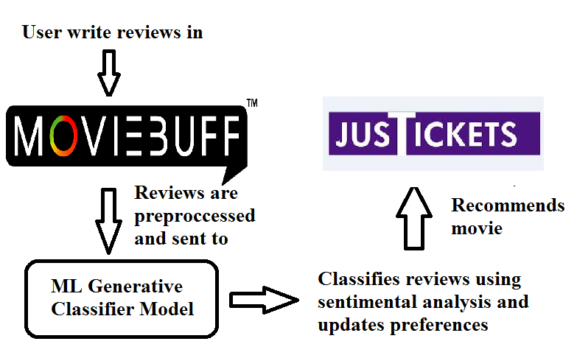
System Design

Slide 5
Machine Learning Model
The machine learning model is pre-trained on a large publicly available Cornel Movie Review Dataset.
The reviews are pre-processed using Preprocessing packages from NLTK and Porter Stemmer
The model takes user reviews and classifies it as positive or negative review using Naïve Bayes Generative Classifier Model

Slide 6
Prediction and Results
The accuracy and F1 score of the Naïve Bayes Generative Classifier Model is 93.27% and 0.877 respectively
ML Model | Accuracy | F1 Score
Naïve Bayes | 93.27% | 0.877
SVM | 91.54% | 0.779
LDA | 85.46% | 0.754
GMM | 84.62% | 0.717

Slide 7
Frontend – Angular6 Functionalites
There are two websites which imitate the functionalities of JusTickets and MovieBuff
The user is uniquely identified based on his login
The reviews are written for specific movies in MovieBuff
The movies are recommended in JusTickets while booking the tickets

Slide 8
Benefits
To users : The user will get to know the movies based on his preferences as movies are recommended personally
To QUBE Cinemas : There will more chance of tickets getting booked as users are recommended of the movies they like and thus increase the customer satisfaction and revenue

Slide 9
Advancements
The reviews can also obtained from MovieBuff endpoint API and user’s social media handles such as Twitter and Facebook
This prototype can be integrated with existing MovieBuff and JusTickets and thus increasing the customer satisfaction and revenue
More features can be added to enhance the ML model such as language etc

Slide 10
THANK YOU
Any Questions?
Email us : vivekraja98@gmail.com
harishharish988@gmail.com
rviswa00@gmail.com

